Slide 1








Class : 11 E
Tuesday, Nov 24, 2020

Slide 2



Attitude is a mental position relative to a way of thinking or being.

Slide 3




If you think you can,
you’re right.
If you think you can’t, you’re right again.
Yes,
It is all a matter of a t t i t u d e.

Slide 4
The Positive thinker sees the Invisible, feels the Intangible, and achieves the Impossible.

Slide 5


Your choice of attitude can decide the out come of your life.
Negative thoughts have no power unless you empower them.

Slide 6
Positive attitude helps to cope more easily with the daily affairs of life. It brings optimism into your life, and makes it easier to avoid worry and negative thinking.
It is a mental attitude that expects positive results.

Slide 7

If you are mainly positive, you will be focused on good things, happy thoughts, and successful outcomes.
Otherwise –
if you are mainly negative, you will be
focusing on bad things,
sad thoughts, unsuccessful outcomes and
act and
behave negatively too.

Slide 8








START | THE DAY WITH | L O V E
SPEND | THE DAY WITH | L O V E
FILL | THE DAY WITH | L O V E
END | THE DAY WITH | L O V E

Slide 9
Helps achieving goals and attaining success.
Success achieved faster and more easily.
More happiness.
More energy.
Greater inner power and strength.
The ability to inspire and motivate yourself and others.
Fewer difficulties encountered along the way.
The ability to surmount any difficulty.
Life smiles at you.
People respect you.

Slide 10


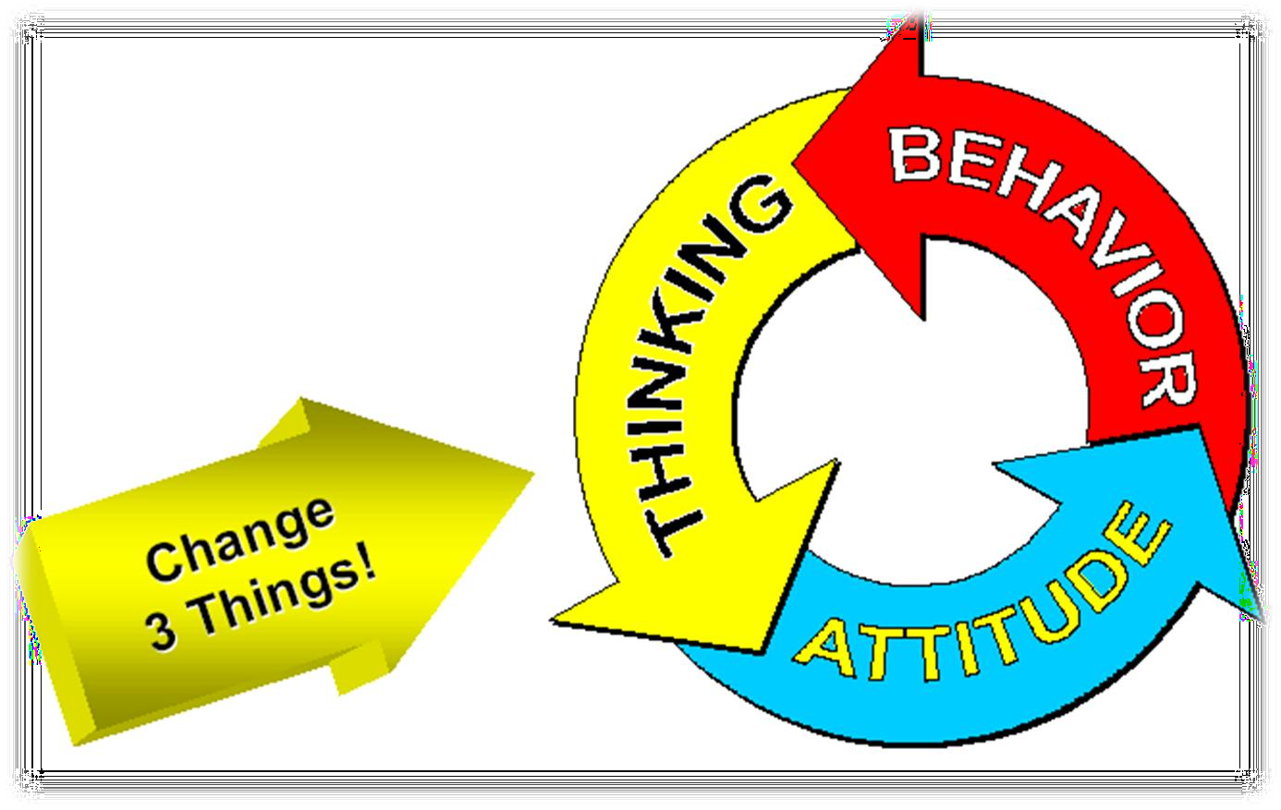

Slide 11



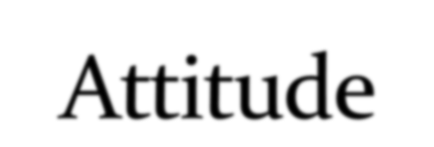








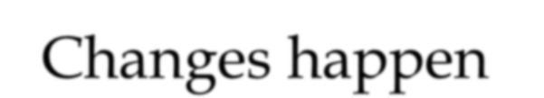
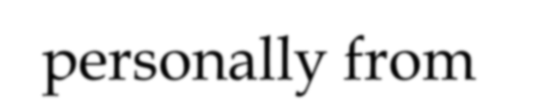
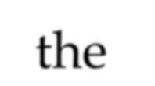
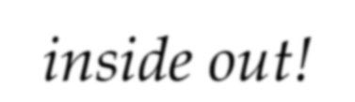
ATTITUDE

Slide 12

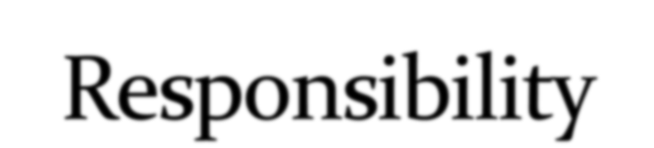


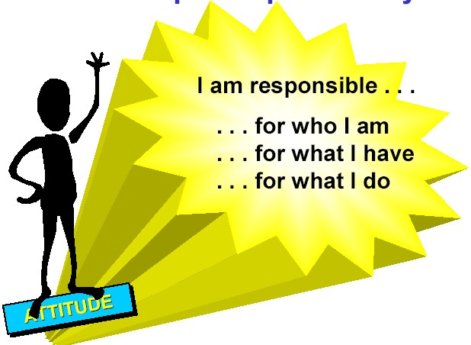

Slide 13



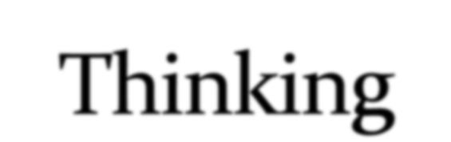





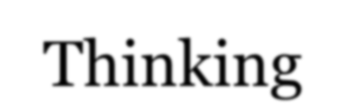
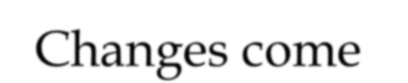
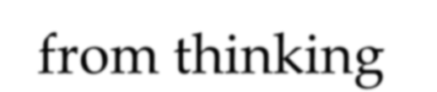
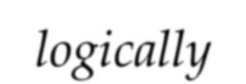
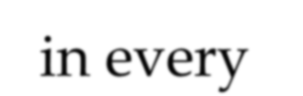
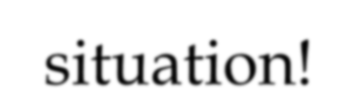
Thinking

Slide 14

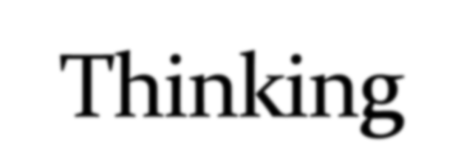


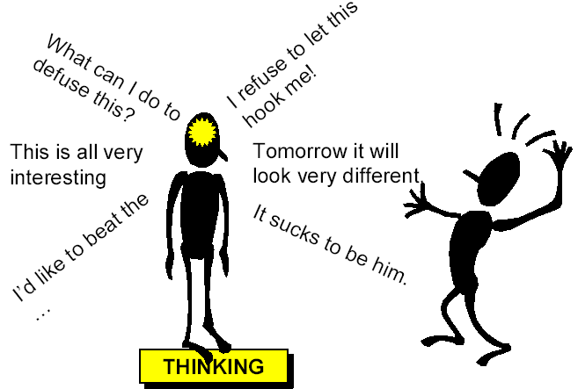

Slide 15

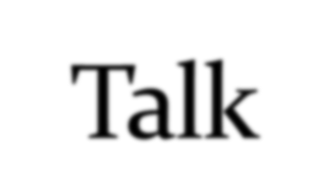


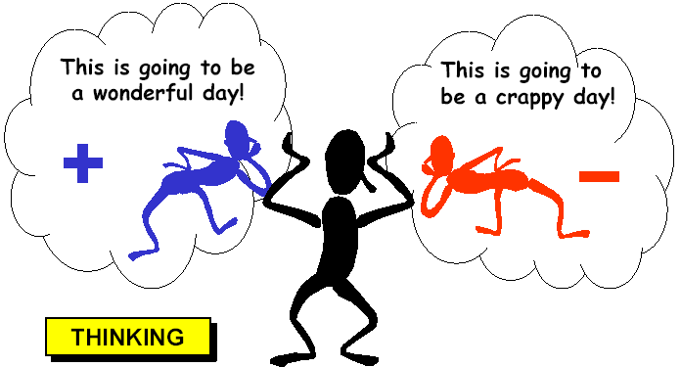

Slide 16
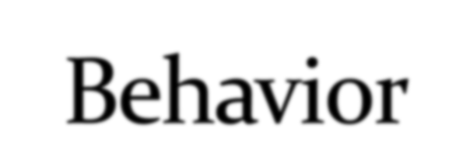


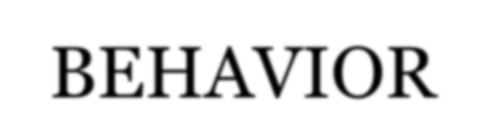


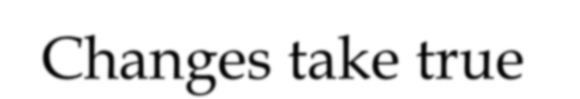
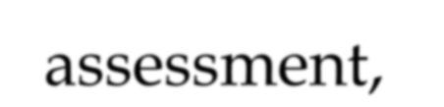
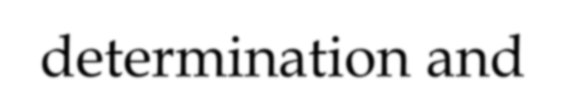
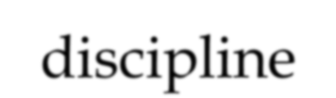
BEHAVIOR
Changes take true assessment, determination and discipline

Slide 17

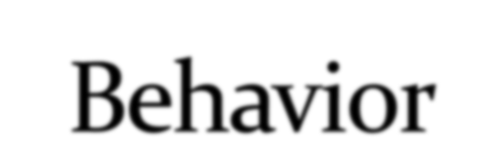


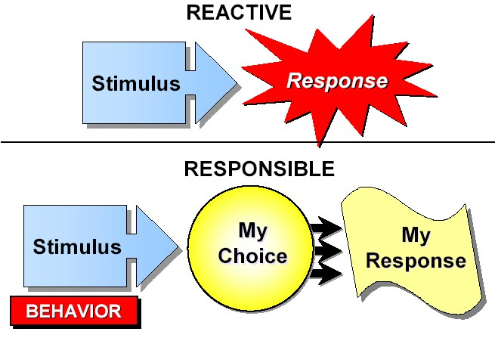

Slide 18



Spread a smile around
Sprinkle some positive on the negatives
Focus on the good of each day
Say please and Thank you
Practice empathy
Evaluate your behavior
Never miss an opportunity to complement
See criticism as opportunity to improve
Keep promises
Cultivate your sense of humor
Keep open mind to changes
Have a forgiving view of people

Slide 19
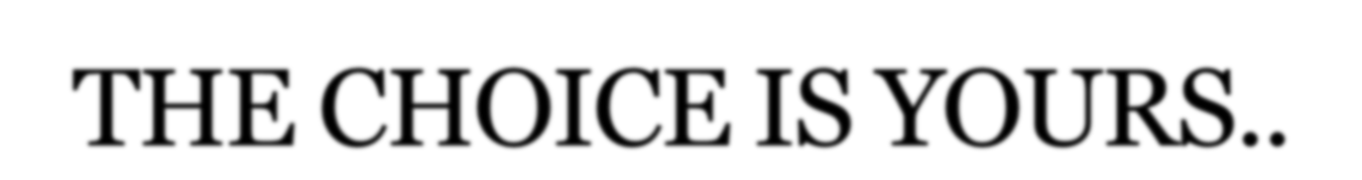
With a Bad Attitude you can never have a
Positive Day
With a Positive Attitude you can never had
Bad Day.
A positive attitude is like a magnet for
positive results

Slide 20
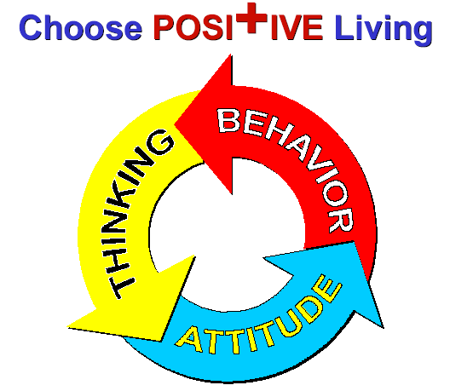

Slide 21






Slide 22


